Slide 1

Stock Forecasting using hidden markov models
Presented by
Ravi Teja Darbha
Ayush Jain
Prateek Mehta

Slide 2

Problem Statement
Stock Markets are one the most complex systems which are almost impossible to model in terms of dynamical equations.
Extract important information of stocks from their historical prices to predict future trends.
Test probabilistic and non-probabilistic models in determining the trends.
Classical problem of non-stationary pattern recognition in Machine Learning.

Slide 3
Proposed Solution
Use probabilistic model – Hidden Markov Models
Train the model using the historical data
Form a generative model
Optimize model and model parameters
Predict next day’s prices- Open Price, Closing Price, High and Low
Use non-probabilistic model – Support Vector Regression
Train the model using the historical data
Predict next day’s prices
Compare the results with the results obtained using HMM

Slide 4
Overview
Hidden Markov Models
Stocks as Hidden Markov Models
How to use Hidden Markov Models?
Prediction of Stock Prices
How to select the best model?
Non-probabilistic model- Support Vector Regression
Results
Conclusion

Slide 5
Hidden Markov Models
Hidden States
Strong probabilistic framework (Generative Model) for recognizing patterns in Stochastic Processes.
Idea behind HMM- The likelihood of the observations depend on the states which are ‘hidden’ to the observer.
The states keep changing as Markov Process with certain transition probability.
The observations can be discrete or continuous but the states are always discrete.
The probability of observations given a state are determined by the emission probability.
Emission probabilities can be PDF or PMF
S1
S2
S3
y1
y2
y3
Observations

Slide 6
Stocks as Hidden Markov Models
There are underlying ‘hidden’ states which drive the stock prices.
Investor can observe only the stock prices.
States and the transition probabilities are unknown.
Observations are continuous vector- Open Price, Closing Price, High and Low.
Emission probabilities are PDF and assumed to be multivariate Gaussian distribution.

Slide 7







Stocks as Hidden Markov Models
$O_{t}$= Observation on day $t$, daily close, daily open, daily high, daily low
$S_{t}$= State on the day $t$
$T$= Number of observations
$k$= Latency
$N$=Number of States ($S_{t}=s_{1}s_{2}s_{3}..s_{N}$)
$O$=Observation sequence
$P_{0}$=Initial State Probability
$A=\left[a_{ij}\right]$ where $a_{ij}$ is the state transition probability from state $s_{i}$ to $s_{j}$
$μ_{i}$=mean of the multivariate Gaussian distribution of observation of state $i$
$Σ_{i}$=Covariance matrix of the distribution of observation of state $i$
The Hidden Markov Model can be represented as
$$λ=(A, μ, Σ,P_{0})$$
$$S_{t−1}$$
$$S_{t}$$
$$S_{t+1}$$
$$O_{t−1}$$
$$O_{t}$$
$$O_{t+1}$$

Slide 8
How to use Hidden Markov Models?
This is answered by answering following three questions.
Given the model, how likely it is to observe the given sequence of data?
Given the model and observations, what is the best hidden state sequence?
Given the observations, what are the optimal model parameters?
The first problem can be solved by Forward algorithm.
The second problem can be solved by Viterbi algorithm.
The third problem can be solved by Baum-Welch algorithm.
Let’s take a look how we do it.

Slide 9





Prediction of Stock Prices
Consider a window $W_{t}$ of $k$ previous observations from today and calculate its log-likelihood given the model.
Compare it with the log-likelihood of the previous sub-sequences of the same size by shifting the window by one day in the direction of past data.
Identify a sub-sequence $W_{t−j}$ whose log-likelihood is the closest to that of the sub-sequence $W_{t}$.
$$j={argmin}_{i}\left|P\left({O_{t},O_{t−1},O_{t−2}…O_{t−k}}/λ\right)−P\left({O_{t−i},O_{t−i−1},O_{t−i−2}…O_{t−i−k}}/λ\right)\right|$$
where $i=1,2,…,(T/k)$
$$k$$
$$t$$
$$k$$
$$k$$

Slide 10

Prediction of Stock Prices
Calculate the differential price change between the latest day of the window $W_{t−j}$ and it’s next day’s price and add it to the current day’s price to get our next day’s prediction.
$$O_{t+1}=O_{t}+(O_{t−j+1}−O_{t−j})$$
As the true observations are received, they are included in the data set and model is trained again for further predictions.
Performance Metrics for predictions of next $m$ days
MAPE (Mean Absolute Percentage Error)
$$MAPE=\frac{1}{N}\sum_{i=1}^{m}{\frac{\left|Predicted\left(i\right)−True(i)\right|}{True(i)}}$$

Slide 11

Implementation using 4 state model
Pseudocode
Training
Set randomly the number of states to four.
Randomly set the initial state probability $P_{0}$ and transition probability $A$.
Run Baum-Welch algorithm using these initial condition to calculate suboptimal parameters $λ$.
Testing
4. Select a window size $k$.
Calculate the $P(O/λ)$ or –log($P(O/λ)$) for all the sub-sequences.
Identify the sub-sequence whose log-likelihood of its $k$ previous observations is the closest to the sub-sequence whose next day’s price is to be predicted.
Using the differential change as explained before.

Slide 12
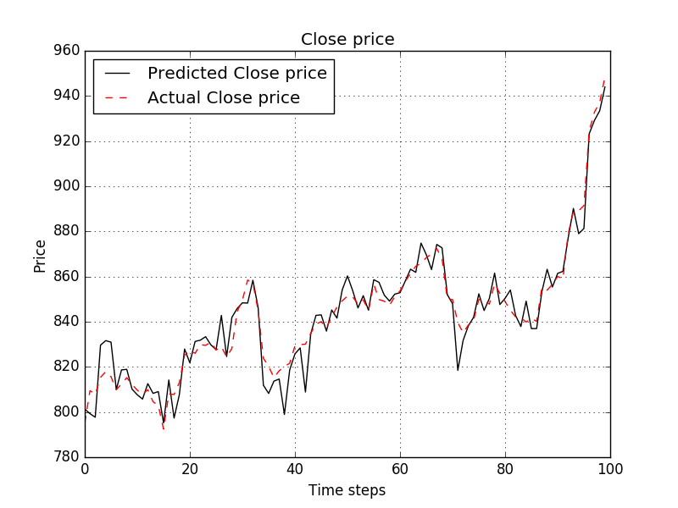
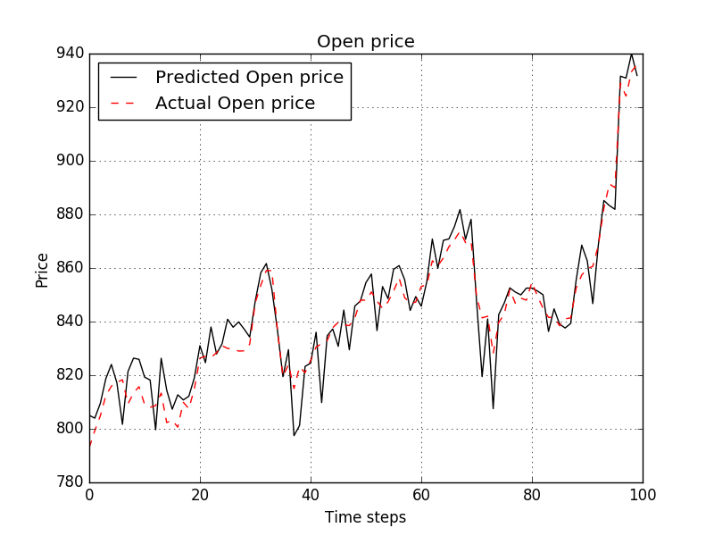
Implementation using 4 state model for Google Inc.

Slide 13
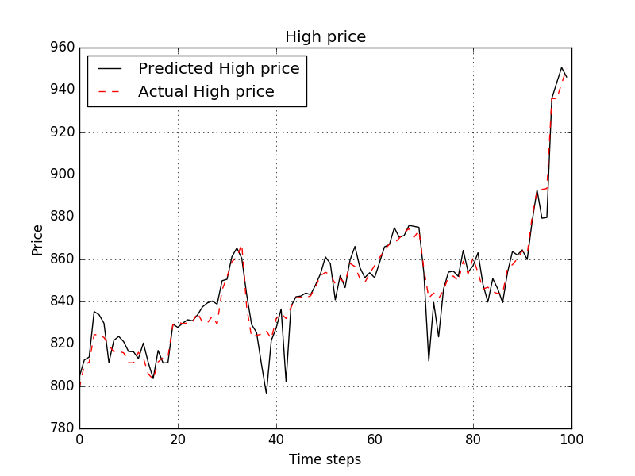
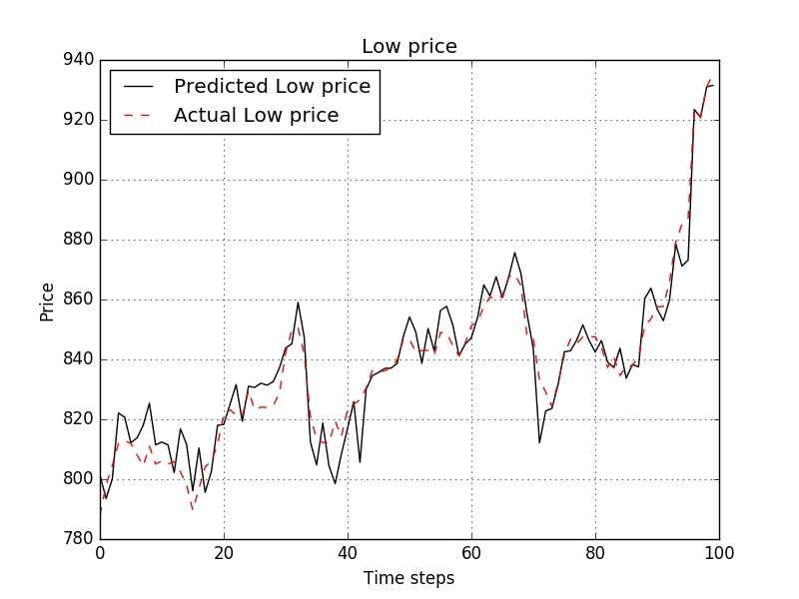
Implementation using 4 state model for Google Inc.
 | Close Price | Open Price | High Price | Low Price
Google Inc. | 0.0057 | 0.0073 | 0.0058 | 0.0067
MAPE for 100 Predictions for stock Google Inc.

Slide 14

How to select the best model?
The lower the negative log-likelihood value is, the better the observations fit in the model.
The negative log-likelihood of the observations $O$ decrease with increase in the number of states but may result in overfitting and increased complexity of the model.
By using Bayesian Information Criterion, complexity of the model can be penalized giving the optimal number of states for a stock.
$$BIC=−2\ln\left(L\right)+p×ln(T)$$
where $L$ is the likelihood function for the model, $T$ is the number of observation points and $p$ is the estimated parameters in the model.
$$p=N^{2}+2N−1$$

Slide 15
Predictions using Non-probabilistic model – Support Vector Regression
Support vector Regression is exactly similar to Support Vector Machines.
In SVM, given the data and labels the model tries to separate as much as possible the different classes by forming an affine plane and deals with predicting the ‘belongingness’ to a class.
In SVR, the model tries to form a surface by fitting the data points as much as possible and predicts a value from a continuous set.
Here the data points are mapped into higher dimensional space where a linear SVM is applied to construct a linear model in this feature space.

Slide 16

Implementation using SVR
Consider the data set $\left(x_{1},y_{1}\right),\left(x_{2},y_{2}\right)$, $\left(x_{3},y_{3}\right)$,…., $\left(x_{T},y_{T}\right)$ where $x_{i}$ denotes all the four prices on day $i$ and $y_{i}$ denote the close price/open price/high/low of the next day $i+1$.
SVR defines a function which takes in the current day’s prices and predicts the next day’s close/open/high/low prices.
SVR is trained with data so far. Current day’s prices are passed to the SVR and next day’s prices are predicted and compared with the true observations.
Then the true observations are included in the training data set to retune the model and make prediction of the day after and so on.
Results show the performance of SVR using linear kernel and compare it with HMM.

Slide 17
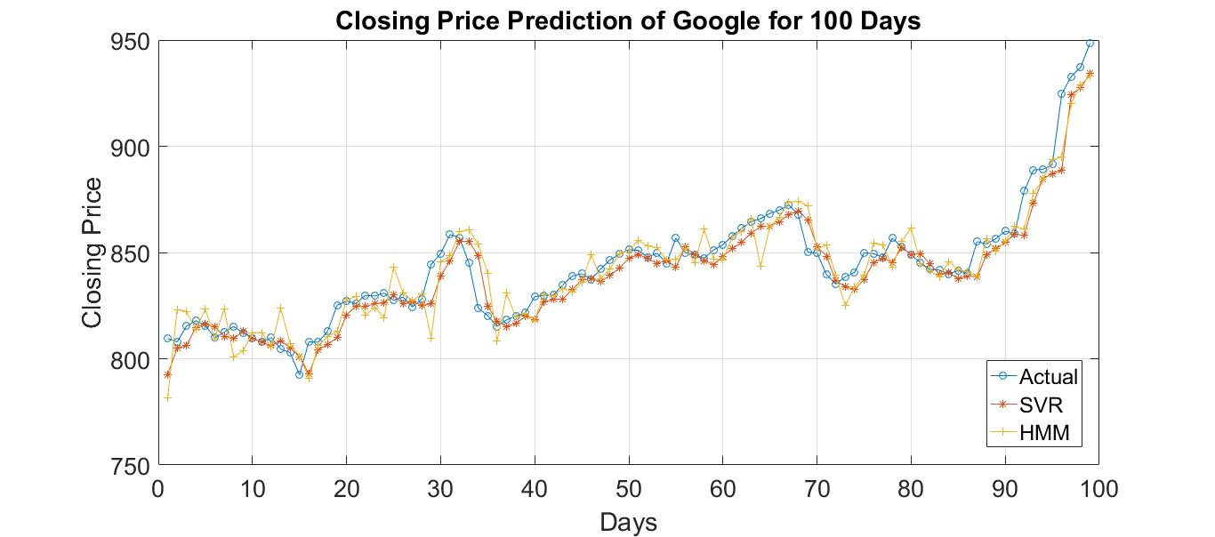
 | Closing | Open | High | Low
HMM | 0.0057 | 0.0057 | 0.0061 | 0.0058
SVR | 0.0071 | 0.0041 | 0.0053 | 0.0062
MAPE for 100 Predictions for stock Google Inc.

Slide 18
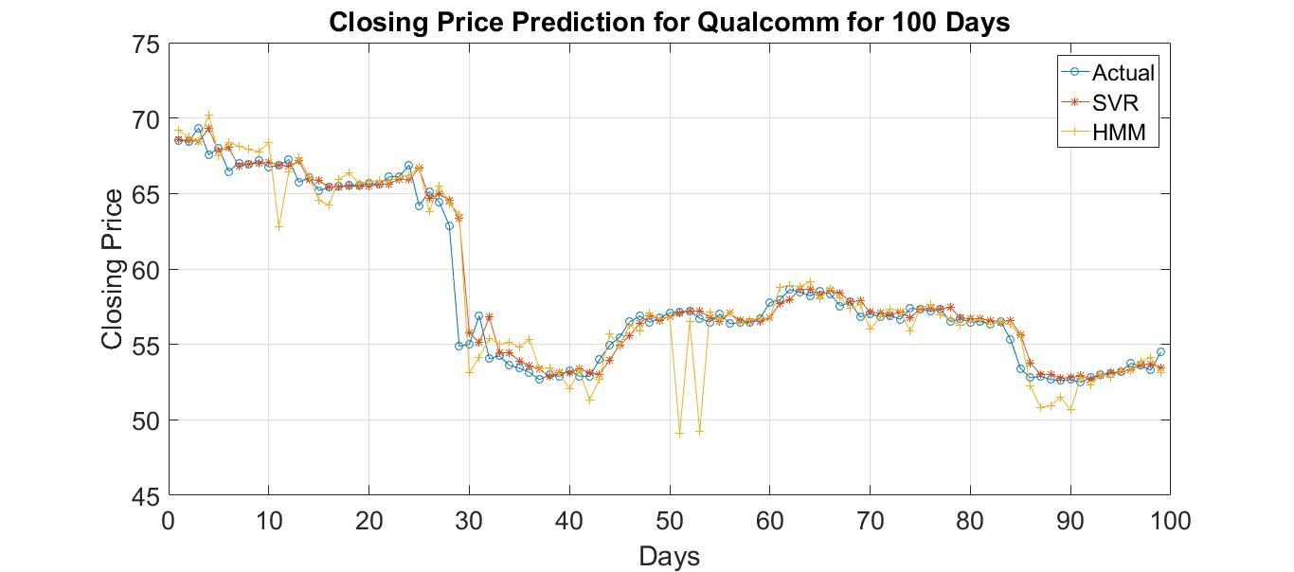
 | Closing | Open | High | Low
HMM | 0.0124 | 0.0132 | 0.0113 | 0.0122
SVR | 0.0098 | 0.0078 | 0.0082 | 0.0106
MAPE for 100 Predictions for stock Qualcomm Inc.

Slide 19
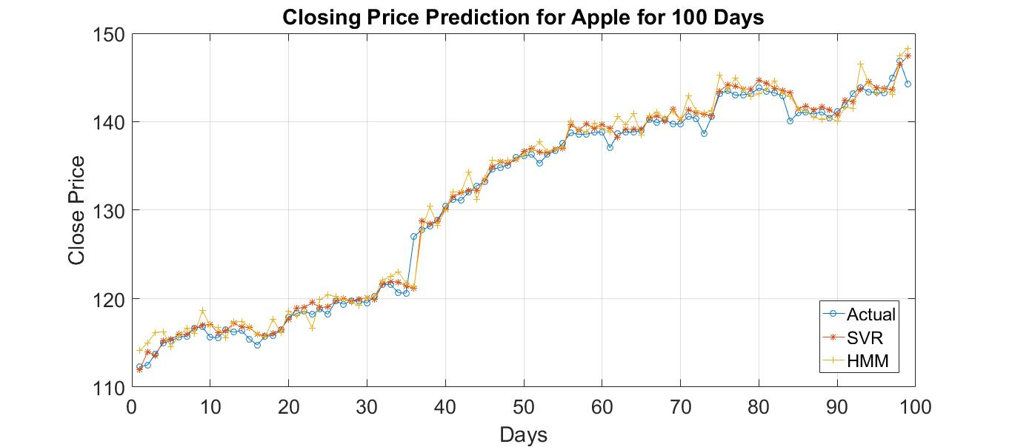
 | Closing | Open | High | Low
HMM | 0.0053 | 0.0057 | 0.0044 | 0.0052
SVR | 0.0052 | 0.0035 | 0.0050 | 0.0059
MAPE for 100 Predictions for stock Apple Inc.

Slide 20
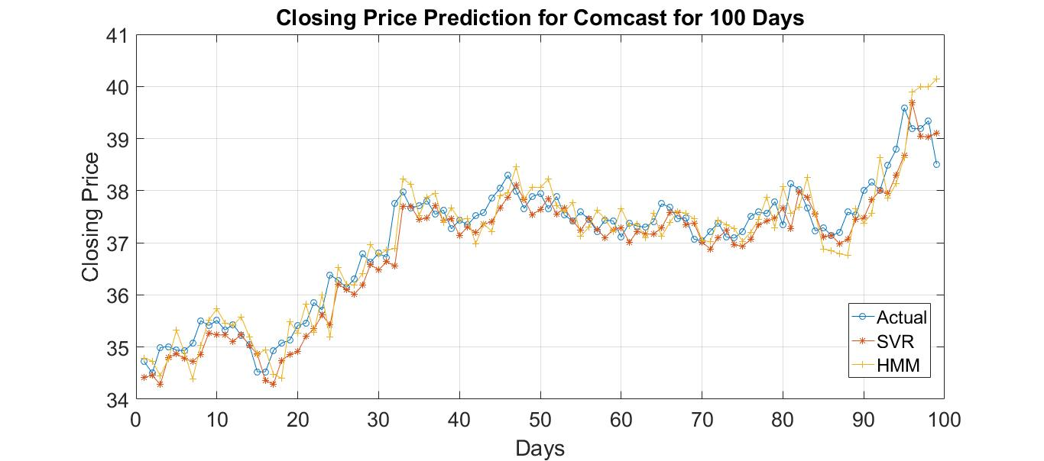
 | Closing | Open | High | Low
HMM | 0.0059 | 0.0070 | 0.0054 | 0.0056
SVR | 0.0075 | 0.0033 | 0.0050 | 0.0047
MAPE for 100 Predictions for stock Comcast Corp.

Slide 21
Conclusion
Though in general, the observations will be greatly affected by the choice of model i.e the number of states in Hidden Markov Models, it does not make significant difference when applied to Stocks.
Both HMM and SVR give similar accuracy when the next one day prices are predicted.
The predictions diverge when prices are predicted for more than one day.
HMM captures the volatility of the stock prices while SVR gives more stable predictions.
Finally, it’s not easy to predict stocks beyond a certain point of accuracy.

